Slide 1
AUTOMATIC STRESS RESULTS EXTRACTION FOR SELECTED NODES IN ALTAIR HYPERWORKS AND CORRELATION OF TEST CENTRE DATA
Event
Presenter
Title
Date

Slide 2
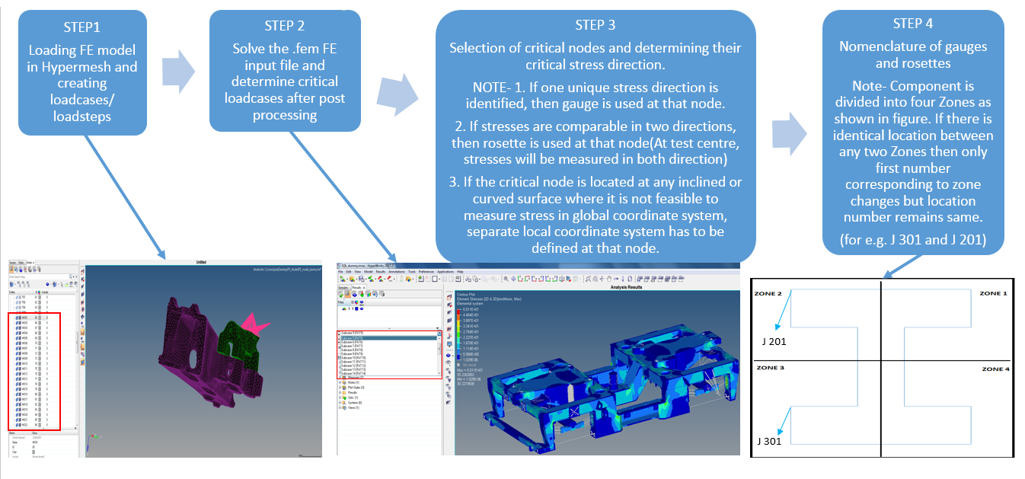
Objective
To create a tool for automatic stress results extraction for selected nodes(in global/local system) in Altair Hyperworks.
To correlate the test centre data with FE data.
Overview of the correlation process

Slide 3
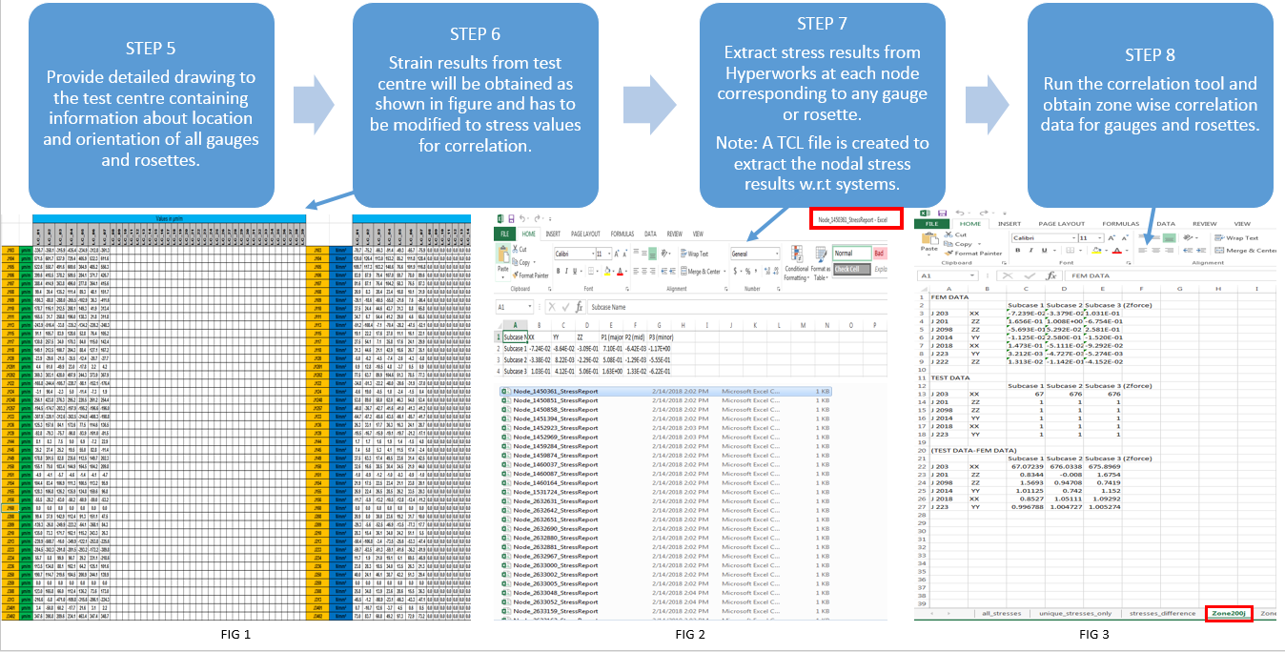
Overview of the correlation process(contd.)

Slide 4
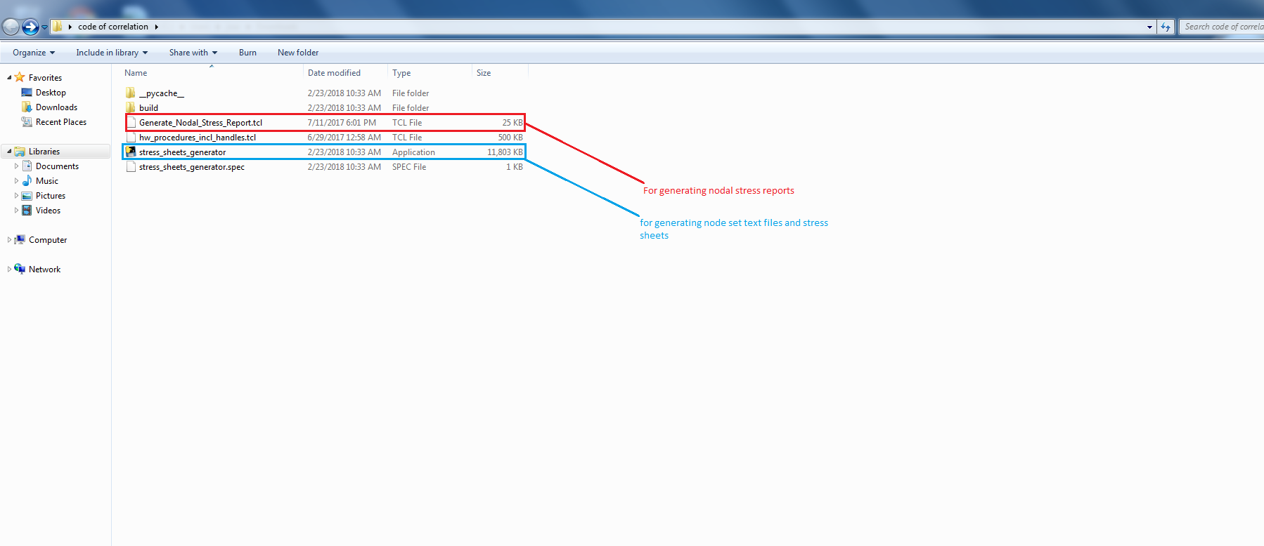
Working folder of tool

Slide 5
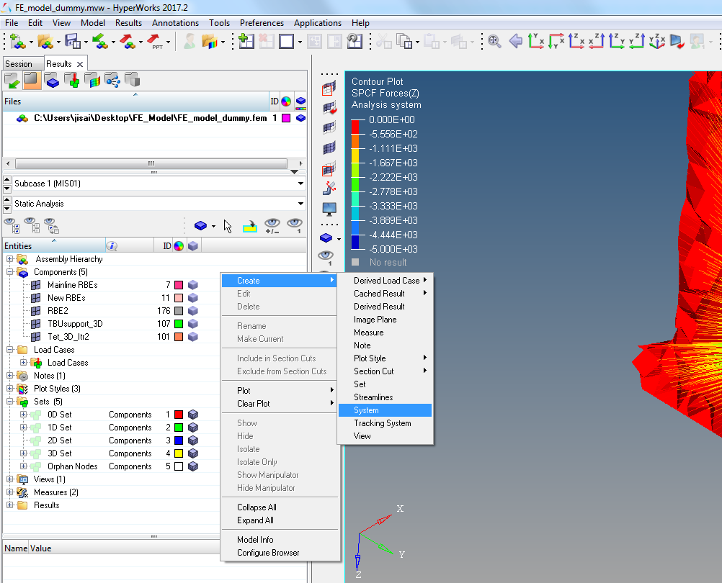
Steps to be followed
Step 1 – Open Hyperworks, analyse results for all loadcases, determine nodes for gauges and rosettes along with their node number, stress direction and coordinate system(i.e. local or global)
a. For creating a new local coordinate system,Create>Systems(shown in the fig)

Slide 6
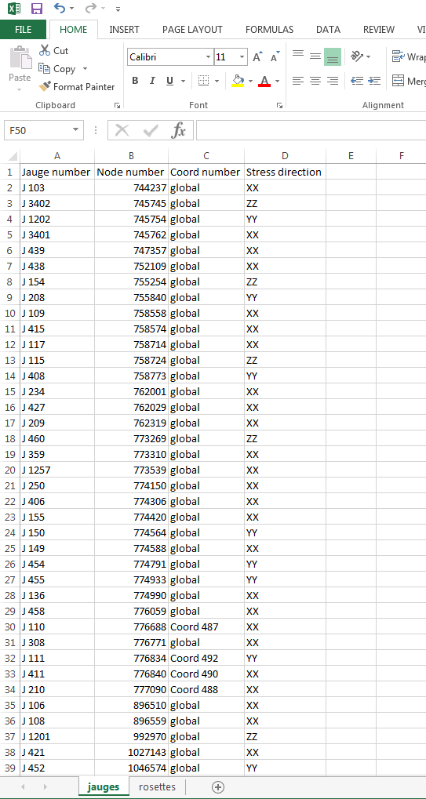
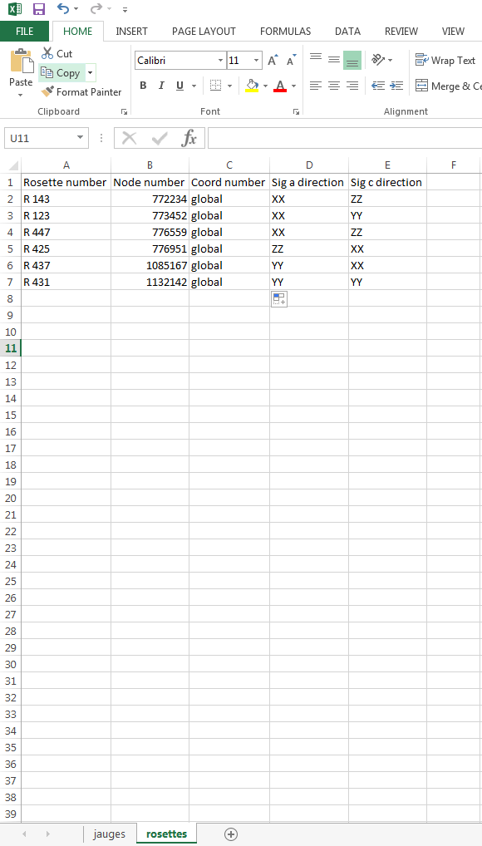
Contd.
Step 2-Create an input excel (.xlsx) file named input_data with the required nodes and their details as shown in fig. (Note that two separate sheets should be created for gauges and rosettes named jauges and rosettes respectively as shown in fig)
1.The file name should be input_data.xlsx and worksheets name should be jauges and rosettes only.
2 for local coordinate system, use user-defined notation.
3.It should be saved in the folder in which stress_sheets_generator.exe is located.

Slide 7
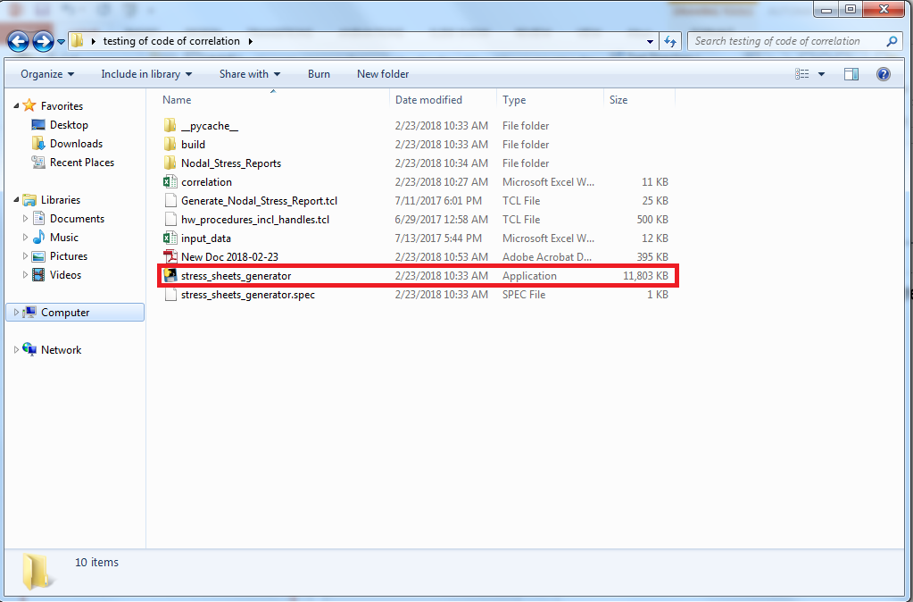
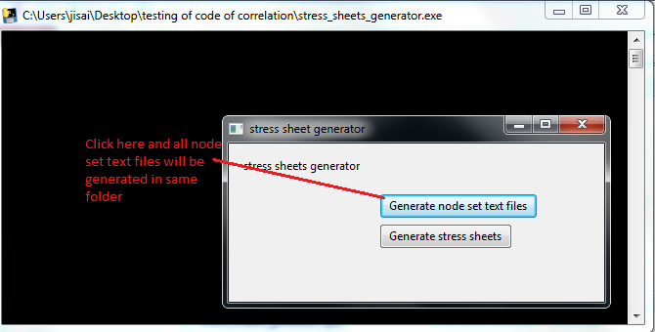
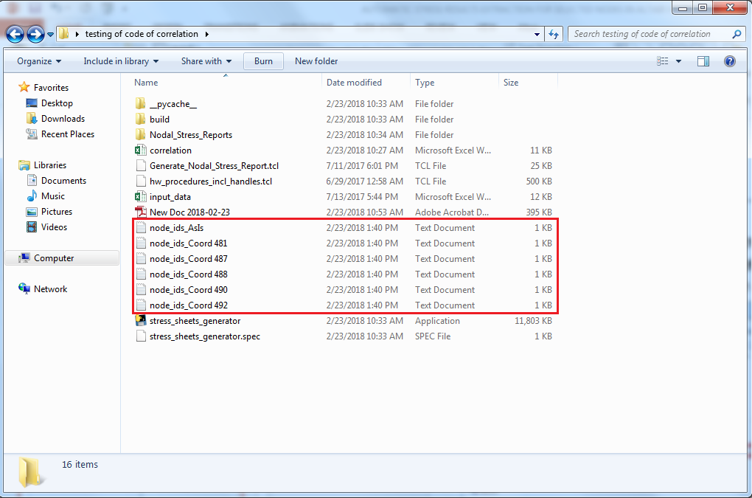
Contd.
Step 3 – Run the .exe file named stress_sheets_generator(fig 1) and as the dialog box appears, click on ‘Generate node set text files’(fig 2).All the node set text files will be generated in same folder as per the assigned coordinate system.
Fig 2
Fig 1
Fig 3

Slide 8
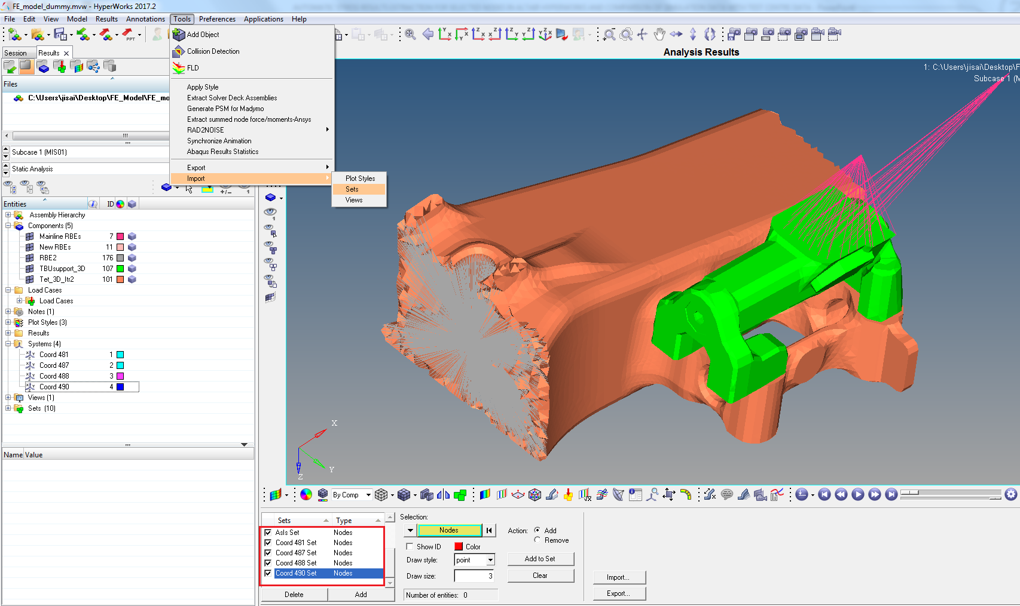
Contd.
Step 4 - Import all the node sets in the text files (Tools>Import>Sets) as shown in fig. one after the other.
1. In HyperView, model should be loaded with .fem file and results should be loaded with .h3d after analysis.

Slide 9
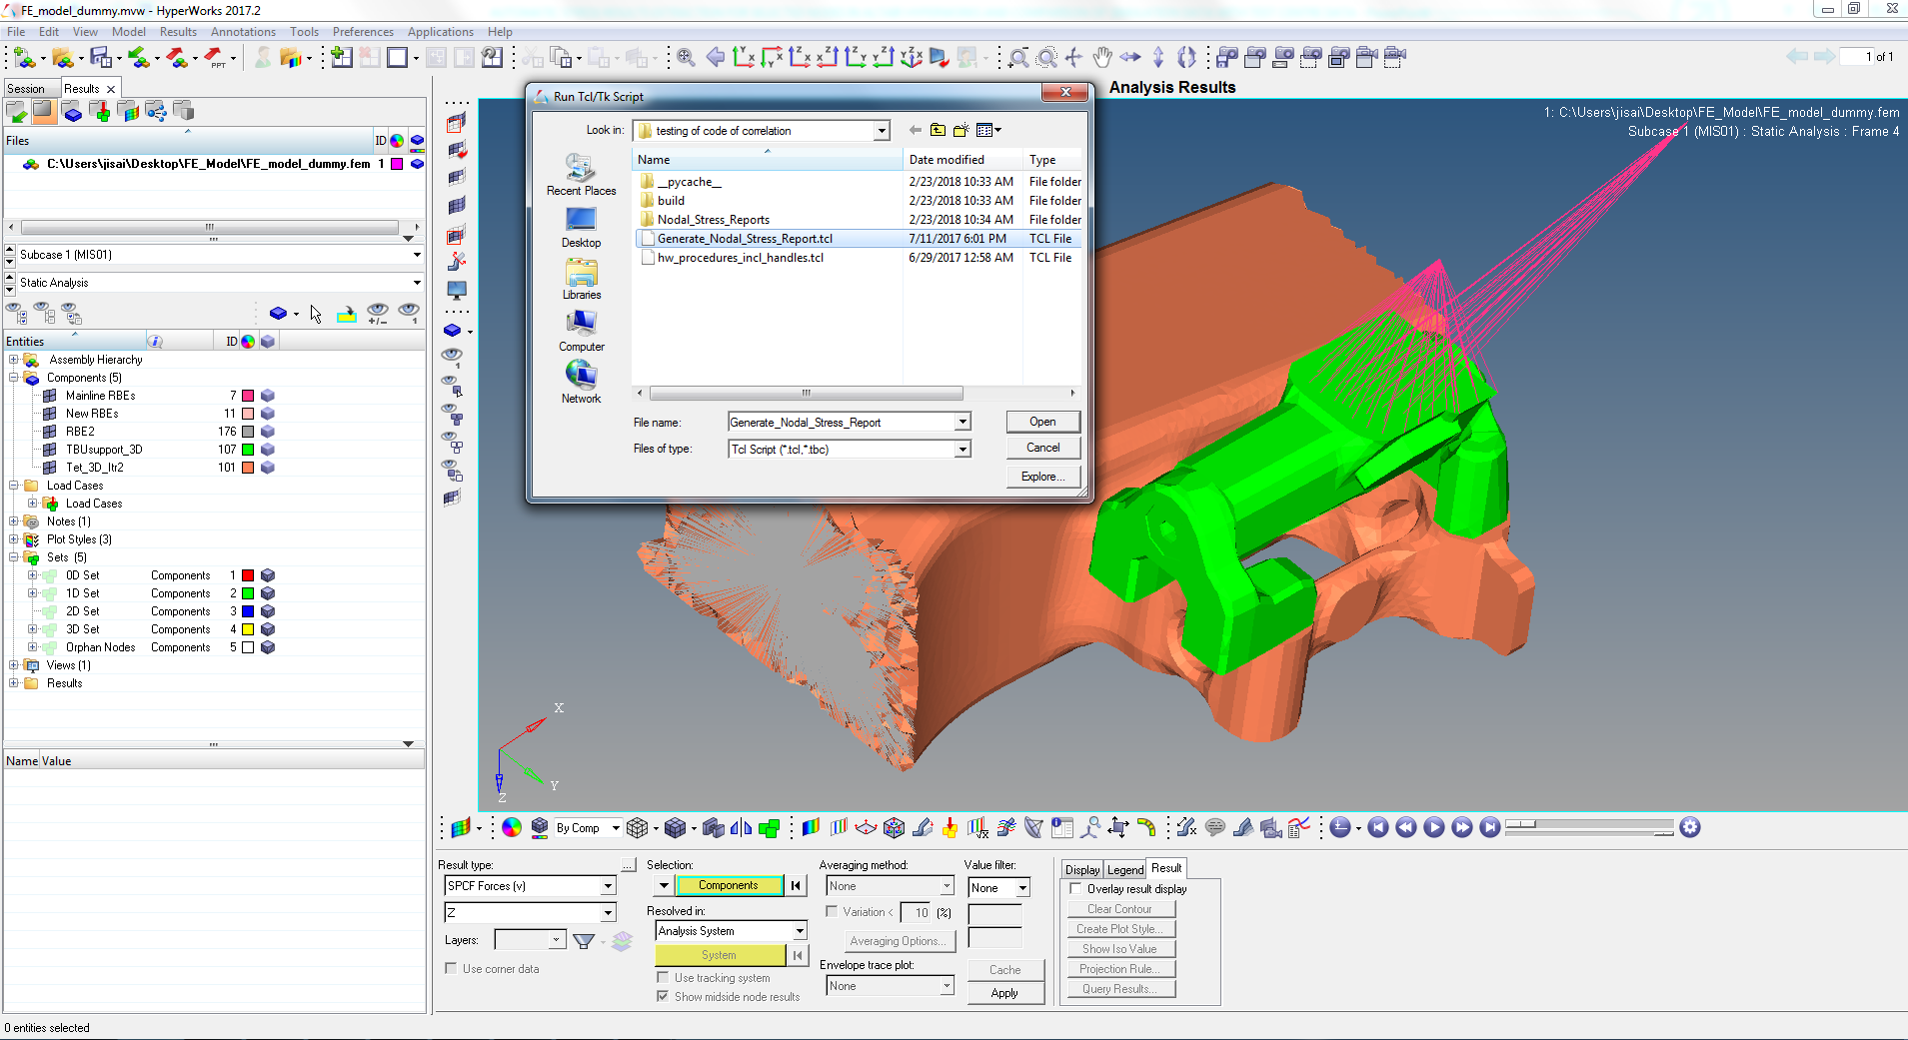
Contd.
Step 5 -Run the TCL script named Generate_Nodal_Stress_Report (File>Run>TCL Script) as shown in fig.
1. The tcl files named ‘Generate_Nodal_Stress_Report.tcl’ and ‘hw_procedure_incl_handles.tcl’ should be always in same folder.

Slide 10
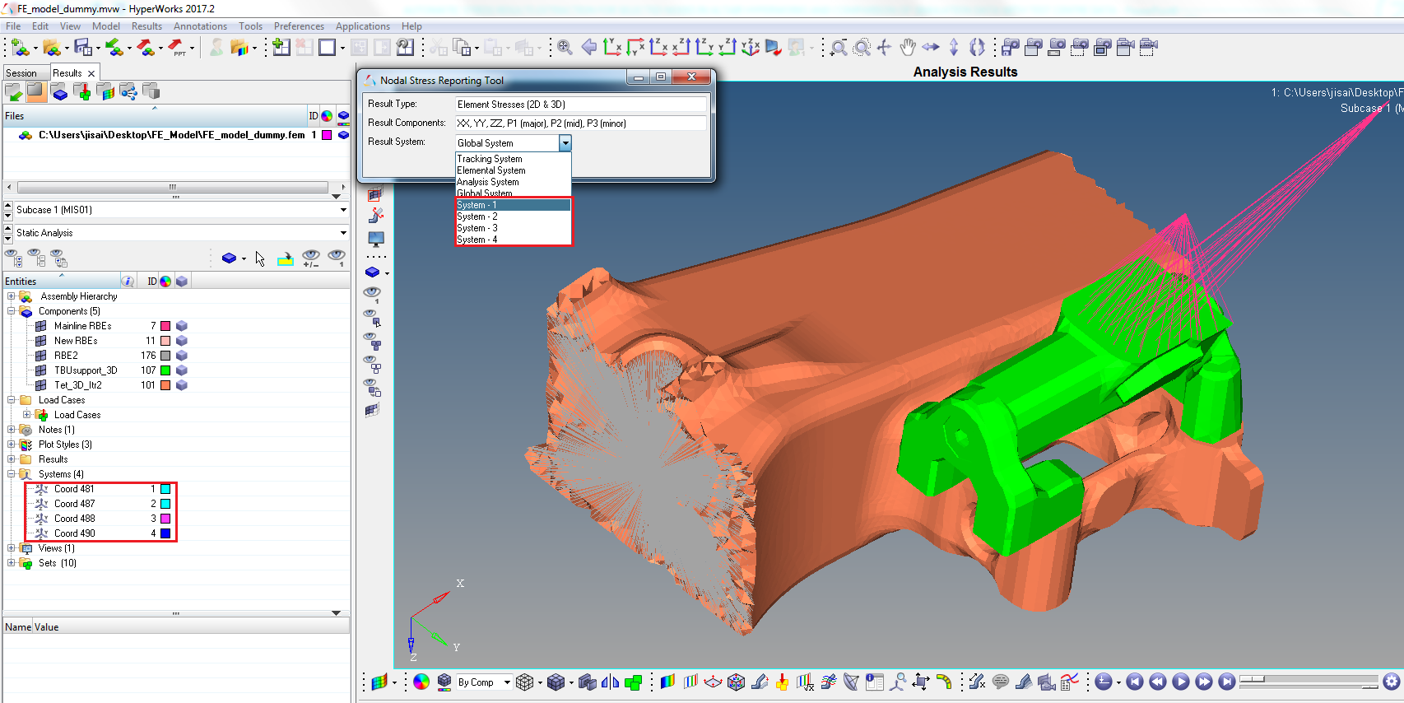
Contd.
Step 6 – As shown in the figure, when tcl file is selected, the dialog box will appear, select the corresponding coordinate system, in which the results are to be exported. Then click on Generate stress report.
In result system drop down option, the local coordinate name is not present, so use the coordinate ID of corresponding local coordinate system for selection.
Repeat step 6 to step 9, whenever new coordinate system has to be selected.

Slide 11
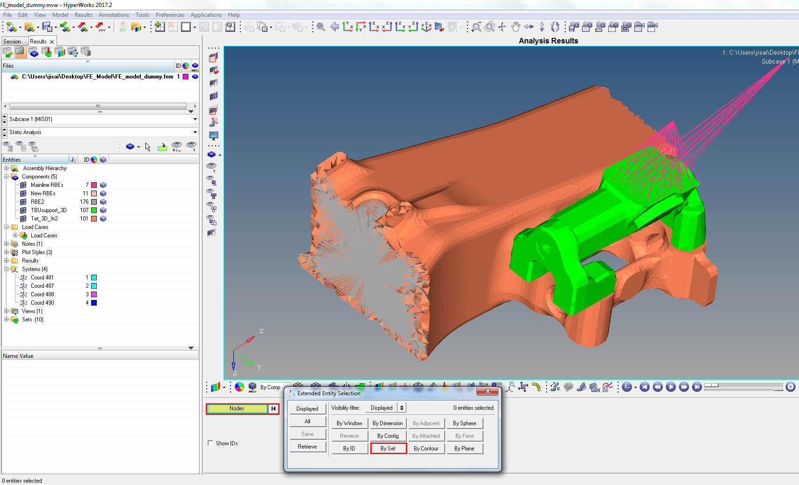
Contd.
Step 7 - Click on “Nodes” button, then click on “By Set” button.(as shown in fig)

Slide 12
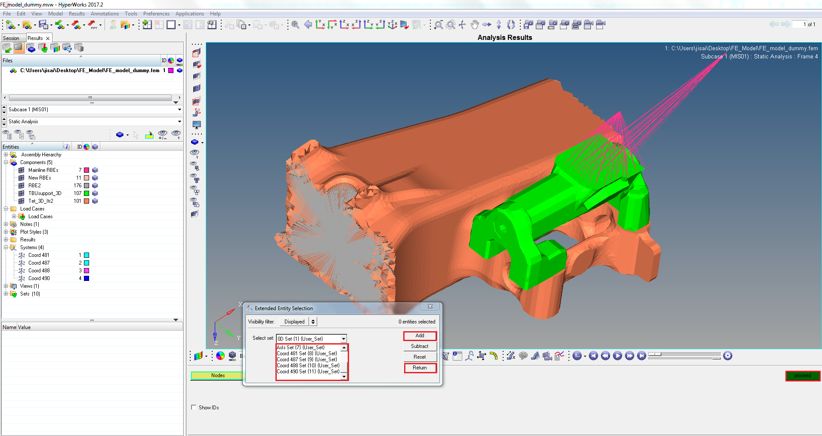
Contd.
Step 8 - Select the node set (global or previously defined), click “Add”, click “Return” and click “proceed” as shown in fig.

Slide 13
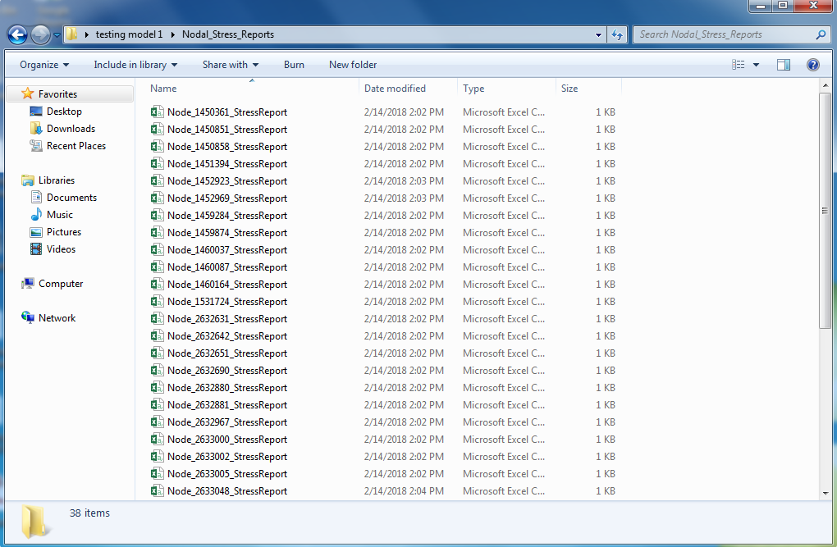
Contd.
Step 9 – Create folder named ‘Nodal_Stress_Reports’ and copy all the generated .csv files to that folder before extracting the results for another coordinate system.
The .csv files are generated in folder named ‘Nodal_stress_reports_filename’. So, always copy all files in ‘Nodal_stress_reports’ folder after every extraction.
After completion of extraction for all coordinate system, move this folder to the folder where Stress_sheets_generator.exe is stored.

Slide 14
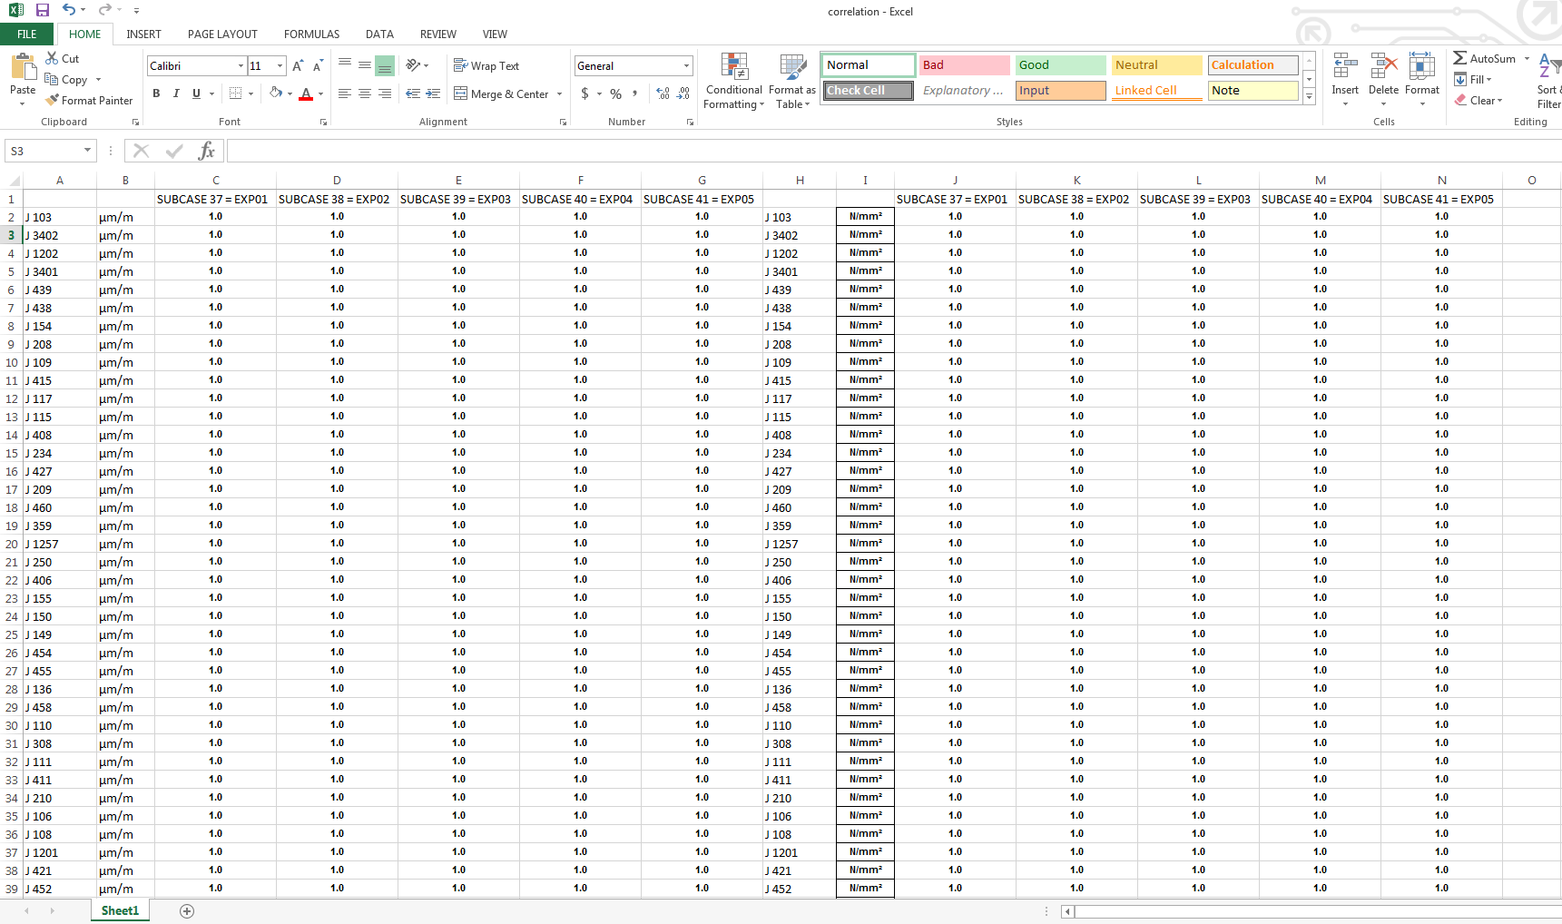
Contd.
Step 10- Arrange the data from the test centre in excel (.xlsx) file named correlation in the following format as shown in the fig.
Stress = E*strain
From test centre, we will get data in the form of strain. But for correlation, stress values has to be derived using above formula and prepare the sheet in same format as shown above.
File name should be ‘correlation’ and worksheet name should be ‘correlation’.

Slide 15
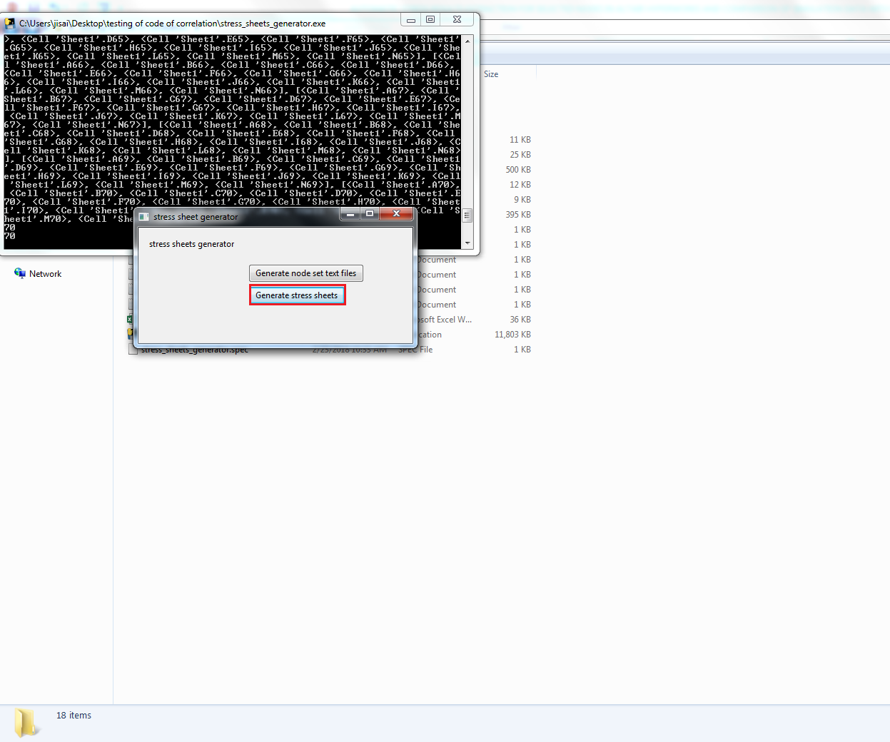
Contd.
Step 11- Run the Stress_sheets_generator.exe file again. Now, click on ‘Generate Stress sheets’.

Slide 16
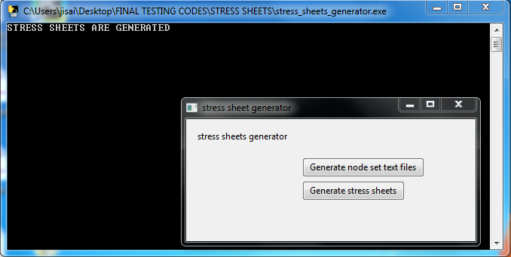
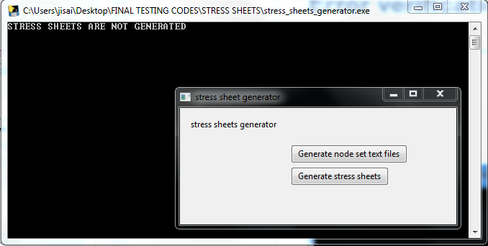
Error verification
After, clicking on generate stress sheets button, “STRESS SHEETS ARE GENERATED” is displayed in the .exe window is program is successfully completed. If there is some error in input file, it will display ‘STRESS SHEETS ARE NOT GENERATED’. Both cases are displayed in figures below.

Slide 17
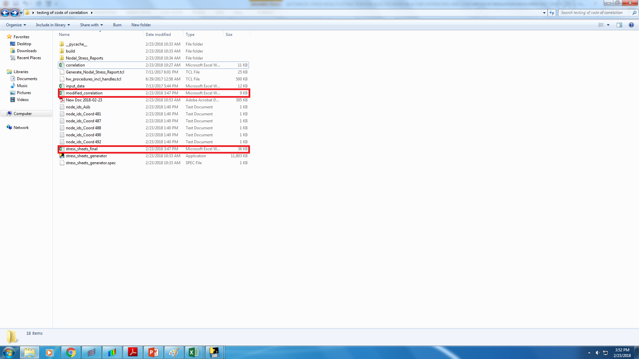
Contd.
Two excel files named stress_sheets_final and Modified correlation are obtained as the output files which contains all the required results and comparisons with the correlation data and calculated values of sigma stresses.
1.For running the .exe file again, copy the input files and generated data in other folder.

Slide 18
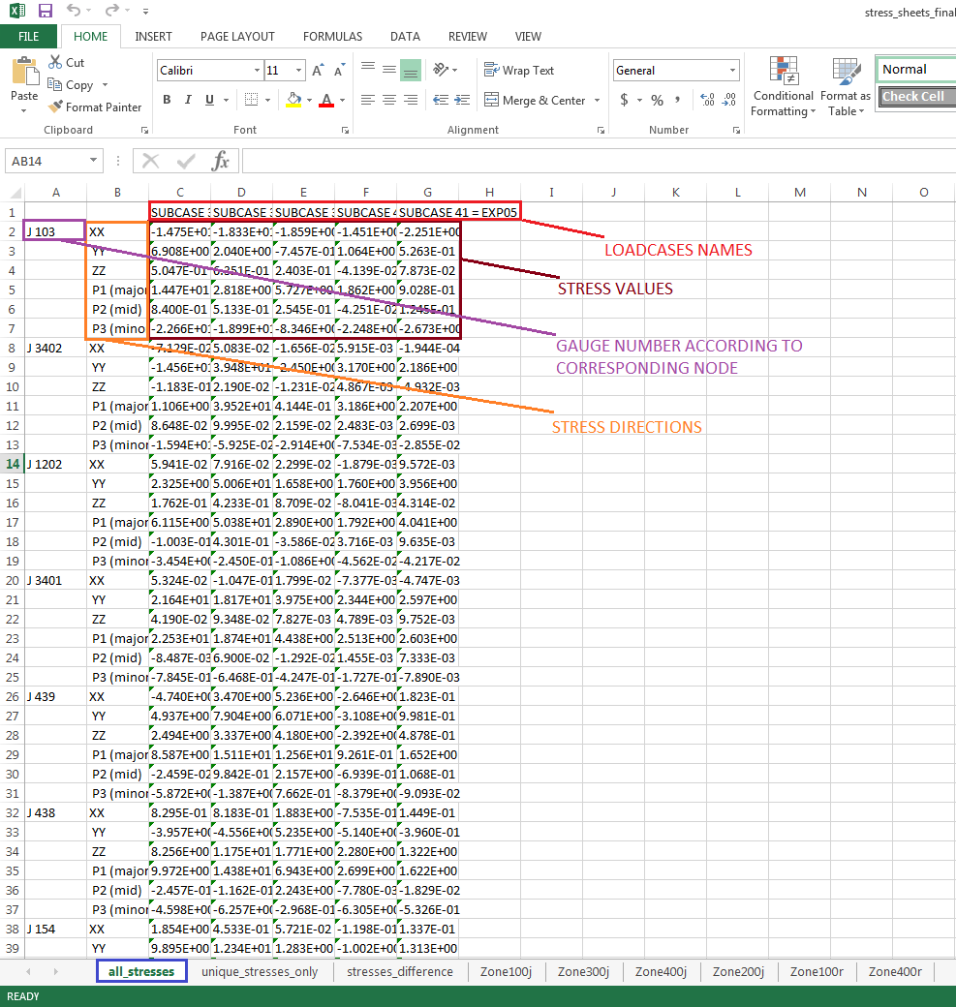
OUTPUT SHEETS DESCRIPTION a. Stress_sheets_final
The first worksheet named ‘all_stresses’ is generated containing stress values for all directions for all loadcases for each gauge and rosette.

Slide 19
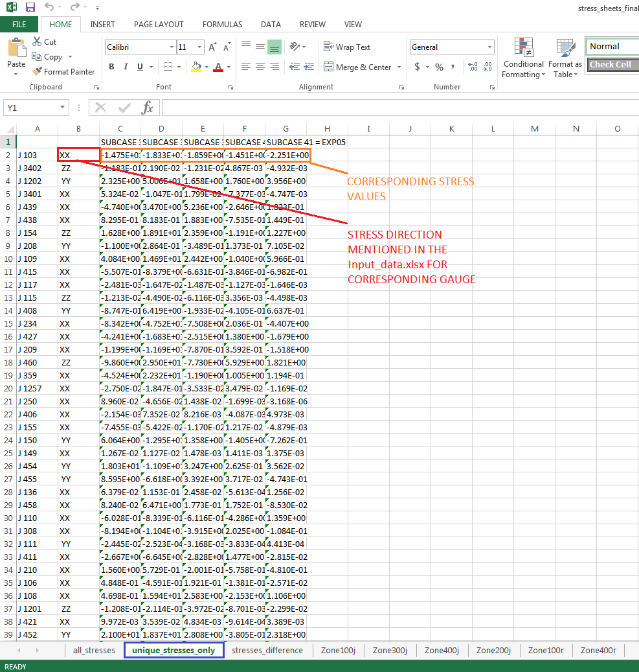
Contd.
The second worksheet named ‘unique_stresses_only’ is generated containing stress values for directions that are given as input in input_data.xlsx file for all loadcases for each gauge and rosette.

Slide 20
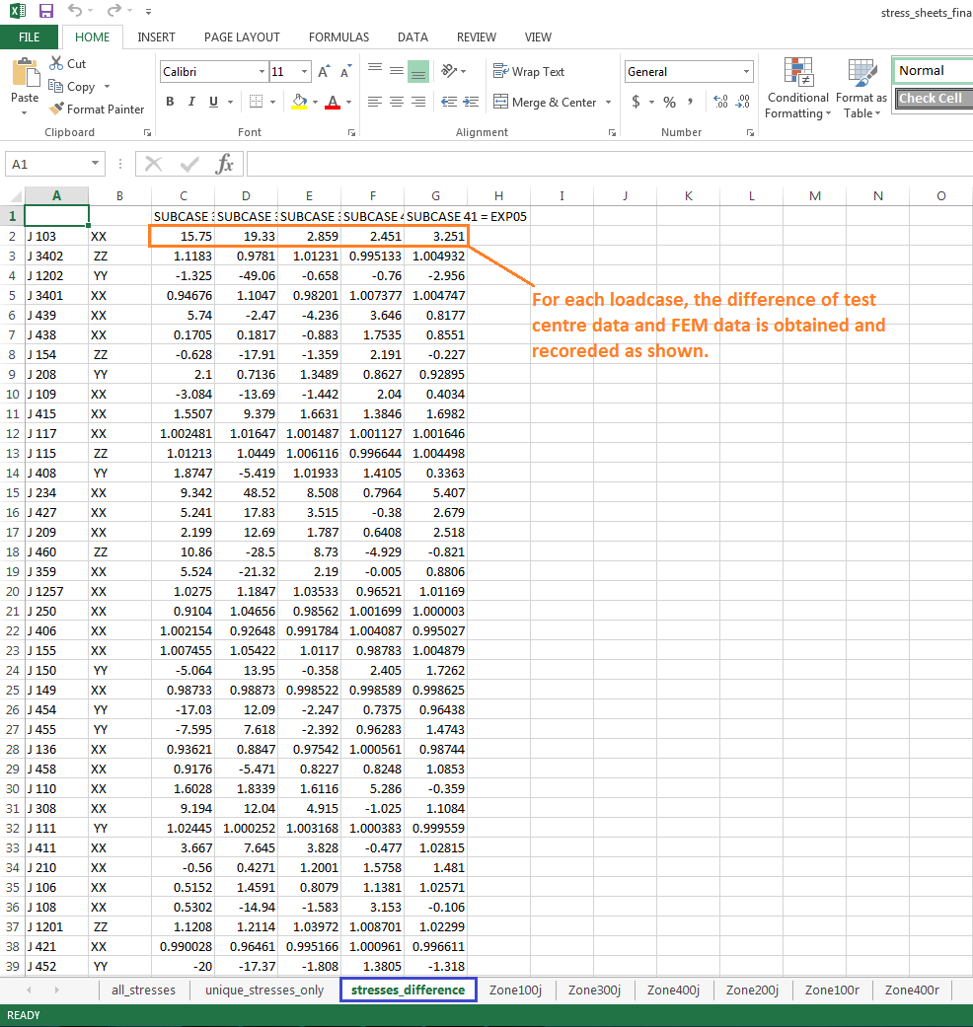
Contd.
The third worksheet named ‘stresses_difference’ is generated containing the difference between test centre data and Fem data for all loadcases for each gauge and rosette.

Slide 21
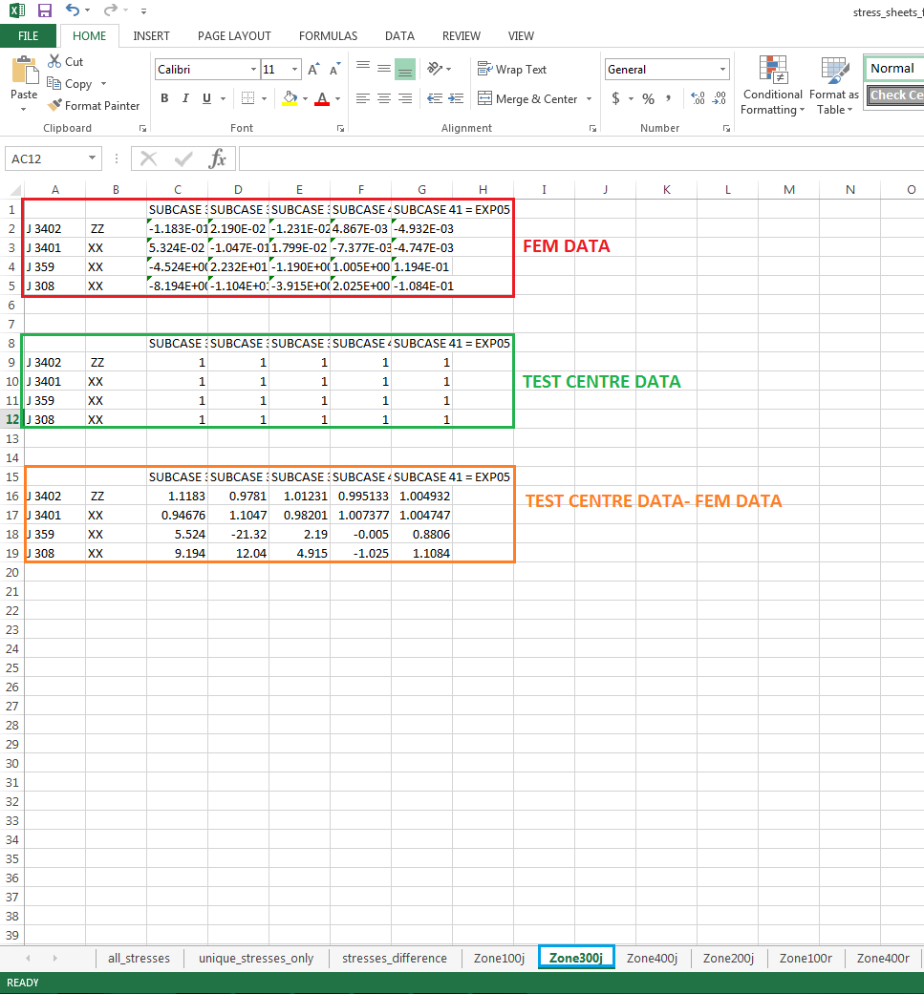
Contd.
For each zone separate sheet will be generated, containing data of FEM, TEST CENTRE and their DIFFERENCE.

Slide 22
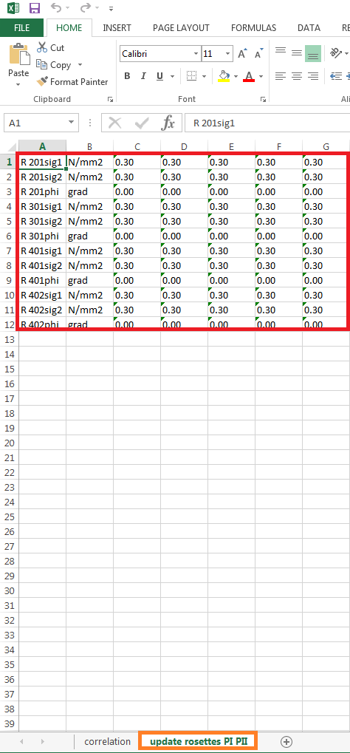
b. Modified_correlation
From test centre data, corresponding stresses are determined, from that values the tool will calculate the value of sig1, sig2 and grad values for each rosette.
Values of Sig1, Sig2 and phi is calculated from test centre data
A separate sheet named update rosettes PI PII is generated in correlation excel

